Slide 1
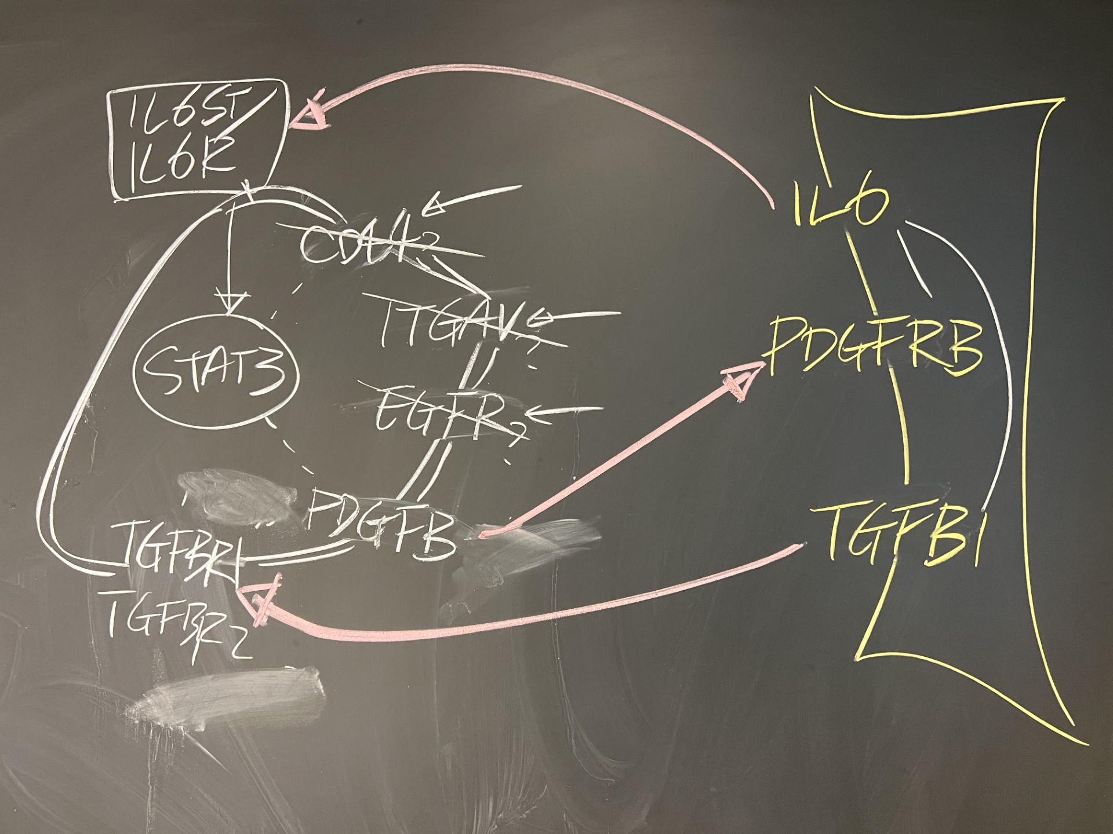

Slide 2
FibroblastGenes = ["TGFB1", "PDGFRB", "IL6"];
CancerGenes = ["STAT3","IL6RorST","TGFBR1or2","PDGFB"];
7 PDGFB -> 2 PDGFRB
1 TGFB1 -> 6 TGFBR1or2
3 IL6 -> 5 IL6RorST
[7 2; 1 6; 3 5; 5 4]

Slide 3
Ideal configuration
[7 2; 1 6; 3 5; 5 4]

